Slide 1


Slide 2
Identity:
Fayez Ahmed
Head Teacher
Keshob Mohajon
Para GPS
Matiranga khagrachari.

Slide 3
Class : One
Subject : English
Time : Forty Minutes

Slide 4
See theVideo

Slide 5


Look at the picture
School

Slide 6
Title of the lesson:
“Good Bye”
Page: 4

Slide 7
Learning Outcomes:
Students will be to -
Understand simple statements
Greet each other e.g. goodgye.
Ricite the rhyme.

Slide 8


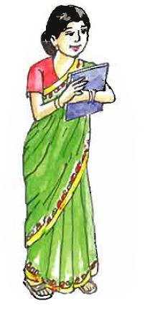
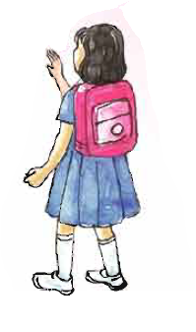
Teachar’s activity
Look,listen and say

Slide 9





Slide 10
Listen to the audio

Slide 11
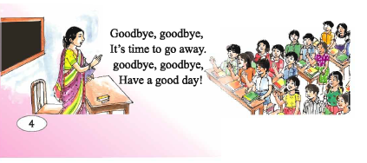
Look,listen and sing.

Slide 12


Students activity : Role play
Bye bye
Bye bye

Slide 13


Vocabulary Presentation:
Goodbye
Away
Fare
well
Far

Slide 14
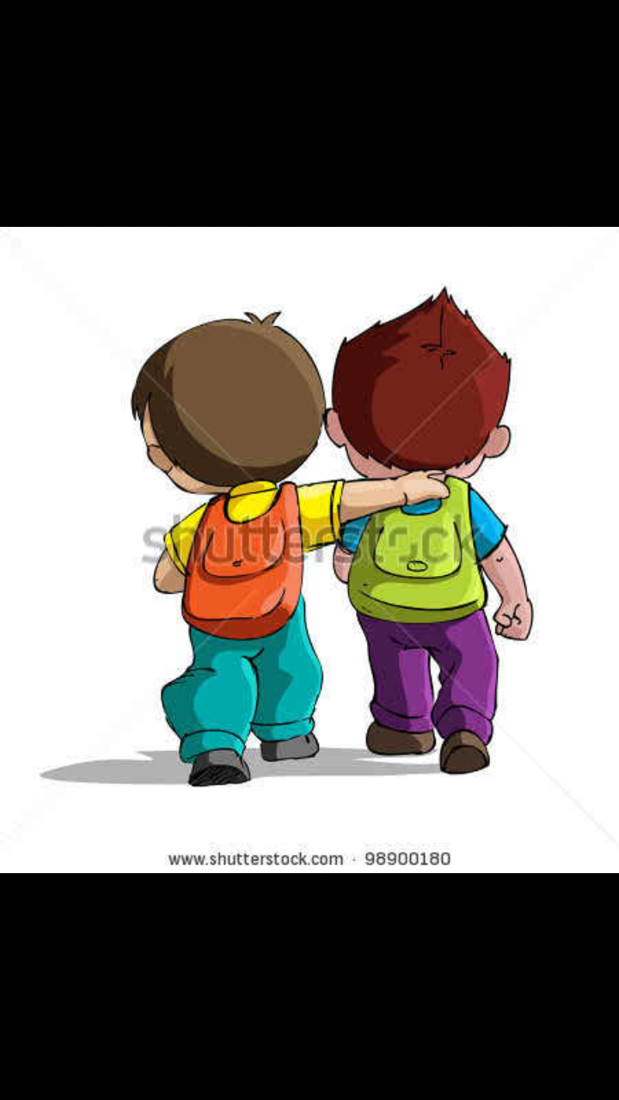

Vocabulary Presentation:
Go
Move
Sunny
time
Day

Slide 15
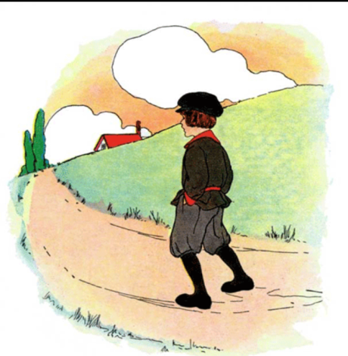
Sing the song
Goodbye,goodbye,
Its time to go away.
Goodbye,goodbye,
Have a nice day.

Slide 16
Recite the next line
Goodbye,goodbye,
Its time to go away.
Goodbye,goodbye,
Have a nice day.

Slide 17


